Slide 1
IoT Based Safety Gadget for Child Safety Monitoring and Notification
UNDER THE GUIDANCE OF:
Mr.K.Muralidharan
ASSISTANT PROFESSOR
PROJECT STUDENTS:
Student Name Reg.No.
SAMUTHIRIKA 1904107
SHAFAHATH 1904110
SOORYA R 2004208
TAMILARASAN M 2004209

Slide 2
OBJECTIVE
To Protect Children from Harassment and misuse
To Protect Children from being Lost
To Constantly monitor the child and inform it to parents
To save them from danger instantly
To update their location using GSM and GPS
To establish a safe and secure society for the children to live

Slide 3
INTRODUCTION
INDIA is the nation with the youngest minds, protecting them and giving a healthy mindset is the duty of every citizen of INDIA.
Our major contribution is in developing a holistic system encompassing the three crucial aspects, i.e. crime analysis and mapping, crime prevention, and emergency response by leveraging societal participation for Children, most of the crimes against Children can be avoided.
If they are given protection with timely help and support. Here the problem of kids from age 5-12 is noted and solution is proposed.
The main problem they face is misguidance, harassment, lack of awareness etc. We propose a model to eliminate these problems

Slide 4
Contd..
We are proposing an easily wearable gadget that is cost efficient and easily accessible by everyone.
It would contain GPS,GSM, Accelerometer sensor, pulse sensor and IoT module all embedded in it and would record all the data such as location, health conditions and sudden rapid movements made and would instantly update all the information to the cloud through which anyone who has the access can view it.
It also has a SOS button through which if it is pressed an automatic alarm will be sent to the relatives and the nearby police station.
By optimizing it we can reduce the latency, increase the response rate and smaller the size making it easy to wear

Slide 5
NEED FOR THE PROJECT
To Protect the child from being Harassed
To Save the children from child Trafficking
To Protect the children from being converted to child labour
To develop them a safe and secure environment to live and grow
In 2020, the government reported identifying 6,622 trafficking victims and 694 potential trafficking victims compared with 5,145 trafficking victims and 2,505 potential victims identified in 2019.
In 2020, authorities identified 5,156 victims in labour trafficking, including 2,837 in bonded labour, and 1,466 in sex trafficking; authorities did not report the type of trafficking for the 694 potential victims

Slide 6
LITERATURE SURVEY
S.NO | TITLE | MODEL / TECHNIQUES USED | MERITS/ DEMERITS | OUTCOMES
1. | Chen, L.W., Chen, T.P., Chen, H.M. and Tsai, M.F., 2019. “Crowdsourced children monitoring and finding with holding up detection based on internet-of-things technologies”,IEEE Sensors Journal, 19(24), pp.12407-12417. | iBeacon 3-axis accelerometer Modules | MERIT: Higher recognition accuracy than existing method DEMERIT: Only 95% success rate of recognition | Find missing children using IoT localization, wearable devices, and surrounding smartphones
2. | Yao, C.Y. and Hsia, W.C., 2018. “An indoor positioning system based on the dual-channel passive RFID technology”,IEEE Sensors Journal, 18(11), pp.4654-4663. | Passive RFID | MERIT: Large positioning area,low RF total radiated power DEMERIT: More time for positioning the tag | A dual-channel low-power passive RFID positioning system

Slide 7
LITERATURE SURVEY
S.NO | TITLE | MODEL / TECHNIQUES USED | MERITS/ DEMERITS | OUTCOMES
3. | Finn, J.W., Wagner, J.R., Walters, E.J. and Alexander,K.E.,2012.“An integrated child safety seat cooling system—Model and test”IEEE transactions on vehicular technology, 61(5), pp.1999-2007. | IOT gateway | MERIT: Ability to maintain an acceptable occupant temperature for elevated cabin temperatures. DEMERIT: The system could not maintain survivable temperatures for extended operating periods. | A thermally protected child safety seat using Peltier effect Thermoelectric modules.
4. | Li, D., Jia, X. and Zhao, J., 2020. “A novel hybrid fusion algorithm for low-cost GPS/INS integrated navigation system during GPS outages” Ieee Access, 8, pp.53984-53996. | Matlab Hybrid fusion Algorithm | MERIT: proposed method meets the real-time requirements of combined positioning systems. DEMERIT: when different equipment and experimental environments are used, we do not claim that the parameters of this article are set to the best combination. | This method can be used in all environments, including frequent GPS outages in urban environments.

Slide 8
LITERATURE SURVEY
S.NO | TITLE | MODEL / TECHNIQUES USED | MERITS/ DEMERITS | OUTCOMES
5. | Haghi, M., Neubert, S., Geissler, A., Fleischer, H., Stoll, N., Stoll, R. and Thurow, K., 2020. “A flexible and pervasive IoT-based healthcare platform for physiological and environmental parameters monitoring”. IEEE Internet of Things Journal, 7(6), pp.5628-5647. | IOT gateway | MERIT: IoT-gateway is flexible to adapt different wearables and the proposed wrist worn prototype is ambient monitoring. | A flexible, pervasive, prolonged, and convenient IoT-based platform for child safety monitoring of ambient, physiological, and behavioral.

Slide 9
INFERENCE FROM LITERATURE SURVEY
Missing children have been found using the iBeacon 3 technology along with axis accelerometer modules with the help of wearable devices and surrounding smartphones.
Dual-channel low-power Passive RFID positioning system can be used for positioning which has high accuracy and low power consumption that can be extended to larger areas.
Temperature can be maintained using thermoelectric modules in case the child is left alone inside the car or any closed environment.

Slide 10
Contd..
Matlab Hybrid fusion Algorithm used for GPS navigation which is of low cost.
Designing a cost efficient wearable that is easy to wear
IoT-gateway as an intermediate hub between physical layer (sensor nodes) and server has been developed for data collection and synchronization to facilitate an efficient end-to end
communication between user and medic in real-time.

Slide 11
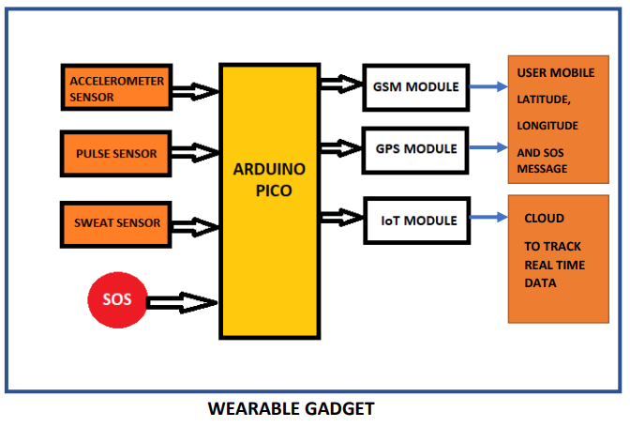
PROPOSED MODEL

Slide 12
HARDWARE/ SOFTWARE TOOL USED
ARDUINO PICO
NB-IoT EC-01-Kit
SIM28ML GSM GPRS Module
ACCELEROMETER SENSOR
PULSE SENSOR
SWEAT SENSOR
ARDUINO IDE

Slide 13
REFERENCES
[1] Shreya G. Zade, Anukesh A. Ambatkar, Prachi J. Bhagat, Vinod B. Ambatkar, Komal A. Korde and Kirti B. Nagne, (2020), “Tracking System Using LoRaWAN Technology”, International Research Journal of Engineering and Technology, vol. 7, Issue No. 12, pp.no. 1448-1451.
[2] Benisha, M., R. Thandaiah Prabu, M. Gowri, K. Vishali, M. Anisha, Ponmozhi Chezhiyan, and C. Jim Elliot. "Design of Wearable Device for Child Safety." In 2021 Third International Conference on Intelligent Communication Technologies and Virtual Mobile Networks (ICICV), pp. 1076-1080. IEEE, 2021.
[3] Nagamma, H. "IoT based smart security gadget for women’s safety." In 2019 1st International Conference on Advances in Information Technology (ICAIT), pp. 348-352. IEEE, 2019.
[4] Isa, M.Z.M., Jamil, M.M.A., Ibrahim, T.N.T., Ahmad, M.S., Abd Rahman, N.A. and Adon, M.N., 2019, November. Children security and tracking system using bluetooth and gps technology. In 2019 9th IEEE International Conference on Control System, Computing and Engineering (ICCSCE) (pp. 184-187). IEEE.

